Slide 1
AMPL related Machine Learning Models and Parameters
Titli Sarkar, Sean Black
Butler Summer Trainee 2022
June 22, 2022

Slide 2
AMPL: End-to-End Data-Driven Modeling Pipeline
Curated Smiles
COc1ccc2[nH]cc(CCNC(C)=O)c2c1
NC(=O)c1cnccn1
Clc1cccc(N2CCNCC2)c1
Nc1c2c(nc3ccccc13)CCCC2
CC(=O)Nc1ccc(O)cc1
CC(=O)Nc1nnc(S(N)(=O)=O)s1
CCCSc1ccc2nc(NC(=O)OC)[nH]c2c1
CC(C)(C)NCC(O)c1ccc(O)c(CO)c1
C=CCc1ccccc1OCC(O)CNC(C)C
CC(=O)Nc1c(I)c(NC(C)=O)c(I)c(C(=O)O)c1I
CCC1(c2ccc(N)cc2)CCC(=O)NC1=O
Train/ val/ test split
Random
Scaffold
Fingerprint
Butina
Temporal
ave_min
Featurize with ECFP or molecular descriptors:
Moe
Mordred
RDKit
ECFP
GraphConv
Model
Random forest
Neural Network
XGboost
Type
Classification
Regression
Predict
Use to predict on Chemical Property e.g., pIC50 value/ Ki value of novel molecules

Slide 3
Train/Validate/Test Split

Slide 4
Random
By far the simplest:
The data is split up into train, validate, and test absolutely randomly
Deep Chem Based
Seed - you can set the random seed to make your split repeatable
Frac_train
Frac_valid
Frac_test

Slide 5
Scaffold
Molecules are grouped by the Bemis-Murcko scaffold representation
Identifies rings, linkers, frameworks, and atomic properties
Groups are split by the number of molecules in each group (decreasing order)
* Requires smiles strings as input
* DeepChem and RDKit based

Slide 6
Fingerprint
Based on Tanimoto similarity between ECFP4 fingerprints
The goal of the fingerprint splinter is to split the molecules such that the molecules in each dataset are as different as possible from the ones in the other datasets.
More stringent of a test on the model
Requires extrapolating data far outside the training data

Slide 7
Butina
Strings are turned into fingerprints.
A (n x n) matrix is generated of Tanimoto similarities between every possible combination of compounds
Clusters are generated based on a cutoff value that user input. Molecules that are within the given cutoff of an identified cluster is considered to be a member of that cluster. The smaller the cutoff, the smaller the clusters.
“designed to generate validation data that are novel chemotypes”
Expected to be classification

Slide 8
Temporal
Date based split: compounds with dates after the user defined "cutoff_date" get sorted into the test set. The rest go to the train/validation sets
The train and validation sets are then further split using another type of splitter that is user defined (Random, scaffold, ave_min)

Slide 9
Ave_min
Creates a split to minimize the Asymmetric Validation Embedding bias
Benchmarks are constructed by selecting a subset of the data that minimizes the difference between the two functions, ensuring the actives are maximally diverse and uniformly embedded within the decoy set
**The AMPL implementation only creates 2 groups, so to use this splitter, it must be called twice in order to get a train, test, and split subgroups**
https://arxiv.org/pdf/1706.06619.pdf

Slide 10
Featurizer and Molecular Descriptor
https://www.youtube.com/watch?v=0j1Eeexd1ig

Slide 11
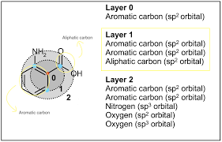
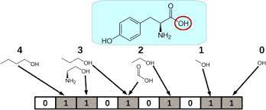
What is Molecular Fingerprints?
Molecular fingerprints are a way of encoding the structure of a molecule.
The most common type of fingerprint is a series of binary digits (bits) that represent the presence or absence of particular substructures in the molecule.
Comparing fingerprints allows you to determine the similarity between two molecules, to find matches to a query substructure, etc.
An example of a binary fingerprint
A circular fingerprint

Slide 12
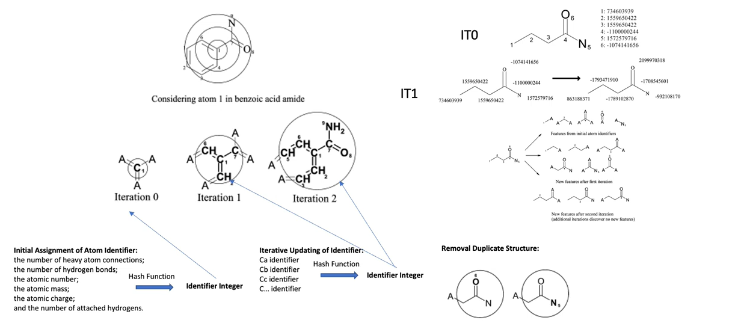
ECFP
Extended-connectivity fingerprints (ECFPs) are a novel class of topological fingerprints for molecular characterization.
J. Chem. Inf. Model. 2010, 50, 5, 742–754, April 28, 2010, doi: https://doi.org/10.1021/ci100050t

Slide 13
RDKit
RDKit is an open-source toolset used in cheminformatics.
Python 3.x wrappers generated using Boost.Python
2D and 3D molecular operations
Descriptor generation for machine learning
Fingerprint Operation Functions [link]:
Generating fingerprints
RDKit fingerprint – based on hashing molecular subgraphs
Morgan/Circular fingerprints - based on the Morgan algorithm, similar to the ECFP/FCFP fingerprints. JCIM 50:742-54 (2010).
Working with fingerprints
Fingerprint I/O
Chemical Descriptors [link]:
rdkit.Chem.Descriptors.Max/MinAbsPartialCharge| MolWt | NumRadicalElectrons | NumValenceElectrons

Slide 14
Moe
Descriptors generated by the commercial software package Molecular Operating Environment [paper link]
Helps in computer-aided molecular design
400+ 2D and 3D Molecular Descriptors
pKa Prediction and Protomer Generation
Linear quantitative structure–activity relationships (QSAR) models
Bayesian Classification / Machine Learning
Chemical Similarity, Diversity and Clustering

Slide 15
Mordred
Molecular descriptors are widely employed to present molecular characteristics in cheminformatics.
Mordred, a developed descriptor-calculation software application that can calculate more than 1800 two- and three-dimensional descriptors.
It is freely available via GitHub
It can calculate descriptors for large molecules, which cannot be accomplished by other software
Moriwaki, H., Tian, YS., Kawashita, N. et al. Mordred: a molecular descriptor calculator. J Cheminform 10, 4 (2018).
DOI: https://doi.org/10.1186/s13321-018-0258-y

Slide 16
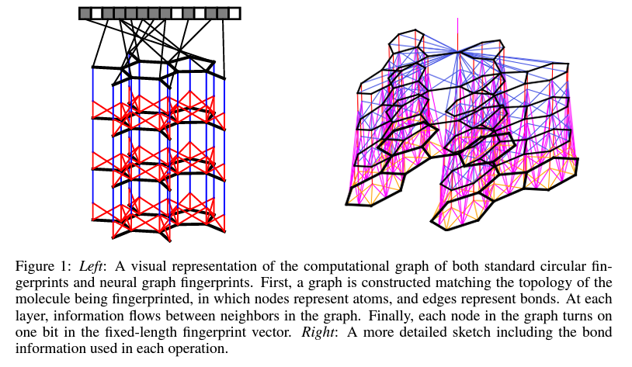
Graphconv
Implemented in Deepchem
Convolutional Neural Nets (CNNs) which can take molecular graphs of arbitrary size as input.
Generalizes standard molecular feature extraction methods based on circular fingerprints.
Useful for predicting the properties of novel molecules
Performs better than Morgan or ECFP
The data-driven features are more interpretable, and have better predictive performance on a variety of tasks.
Journal of Computer-Aided Molecular Design volume 30, pages595–608 (2016), doi: https://doi.org/10.1007/s10822-016-9938-8

Slide 17
ML Model Types

Slide 18
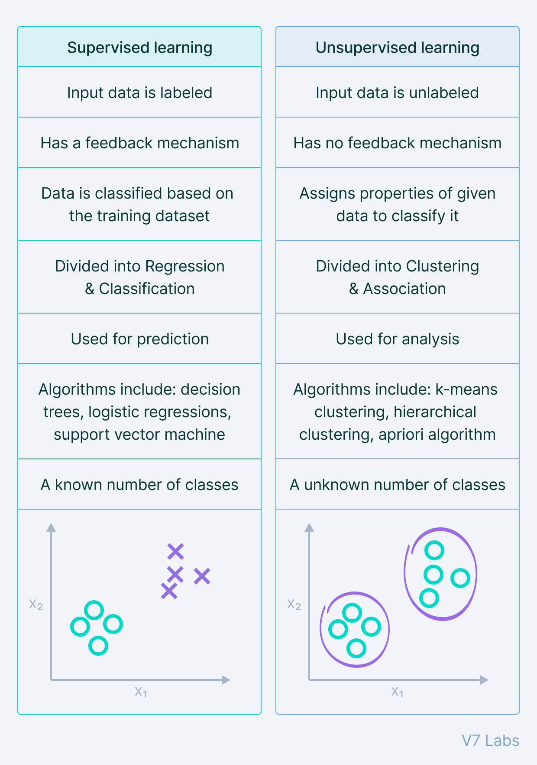
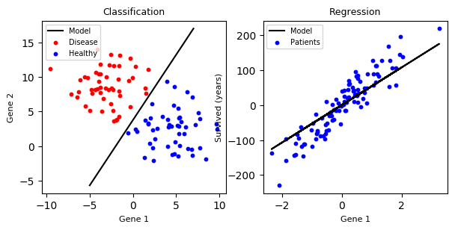
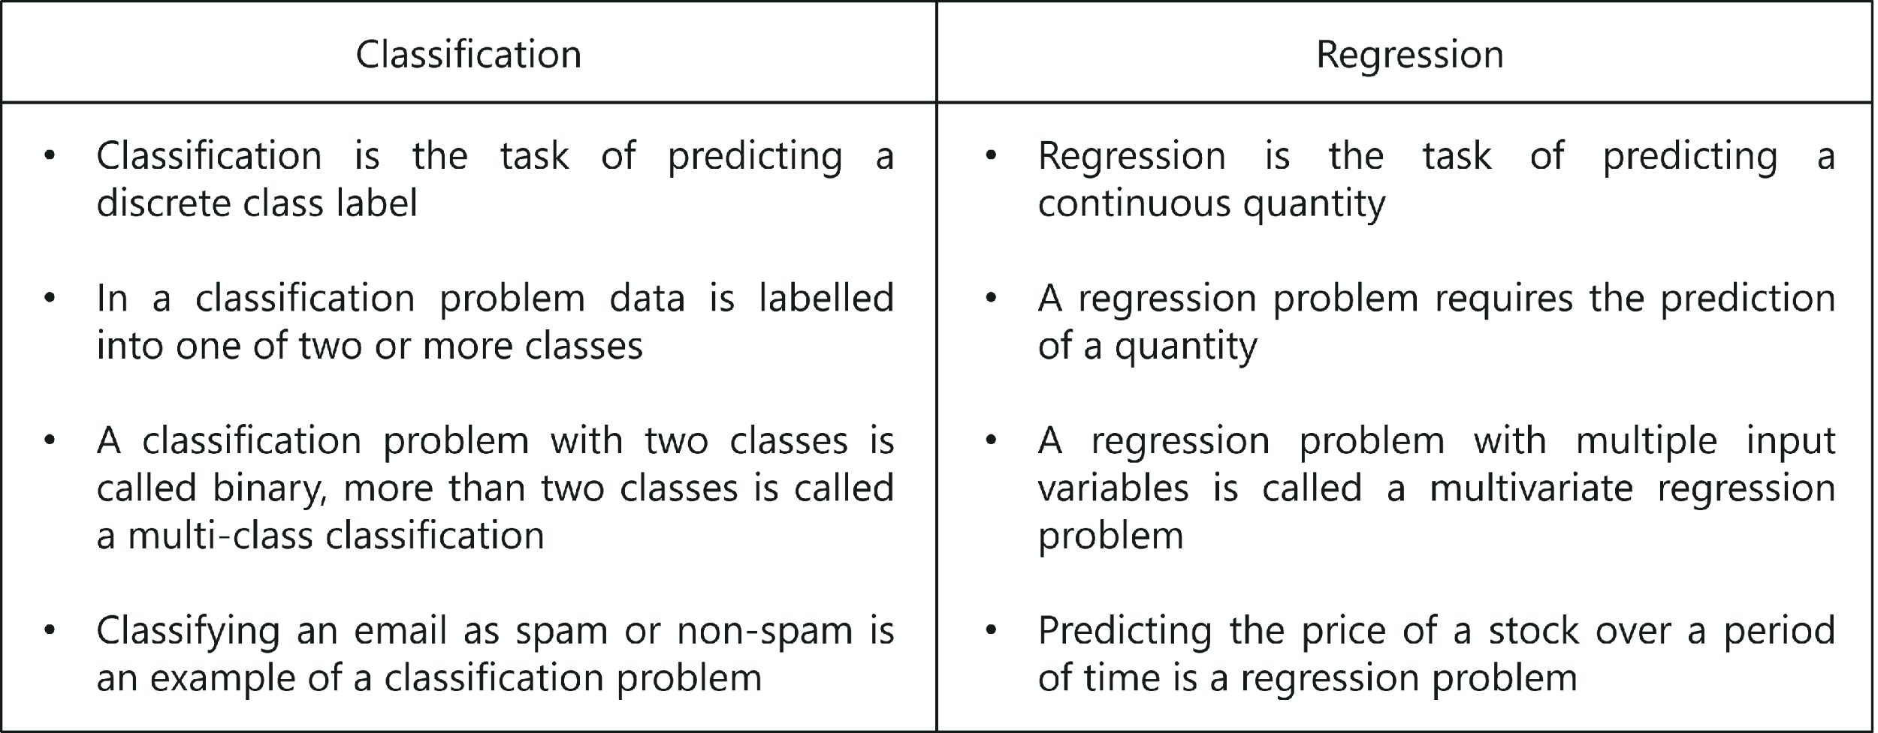
Machine Learning Algorithm Types

Slide 19
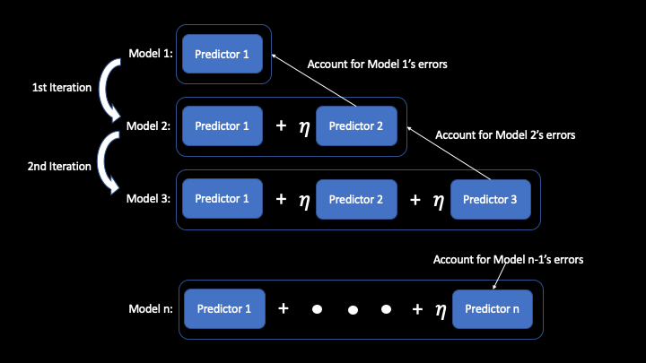
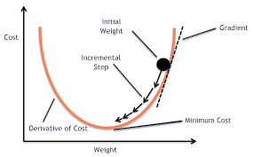
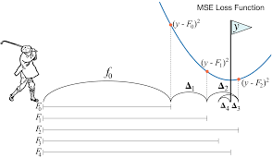
Gradient Boosting
Initial model with random weight
Error = actual – predicted
Minimize errors/cost in incremental steps
Improved model with new weights
Evaluate model

Slide 20
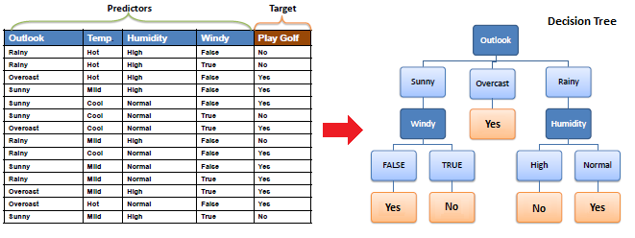
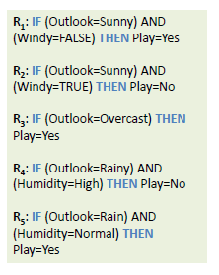
Decision Tree
Decision Trees are supervised Machine Learning techniques where the data is split according to certain condition/parameter.
E.g. Determine if a player should play golf or not based on certain conditions like Outlook, Temperature, Humidity and Windy.

Slide 21
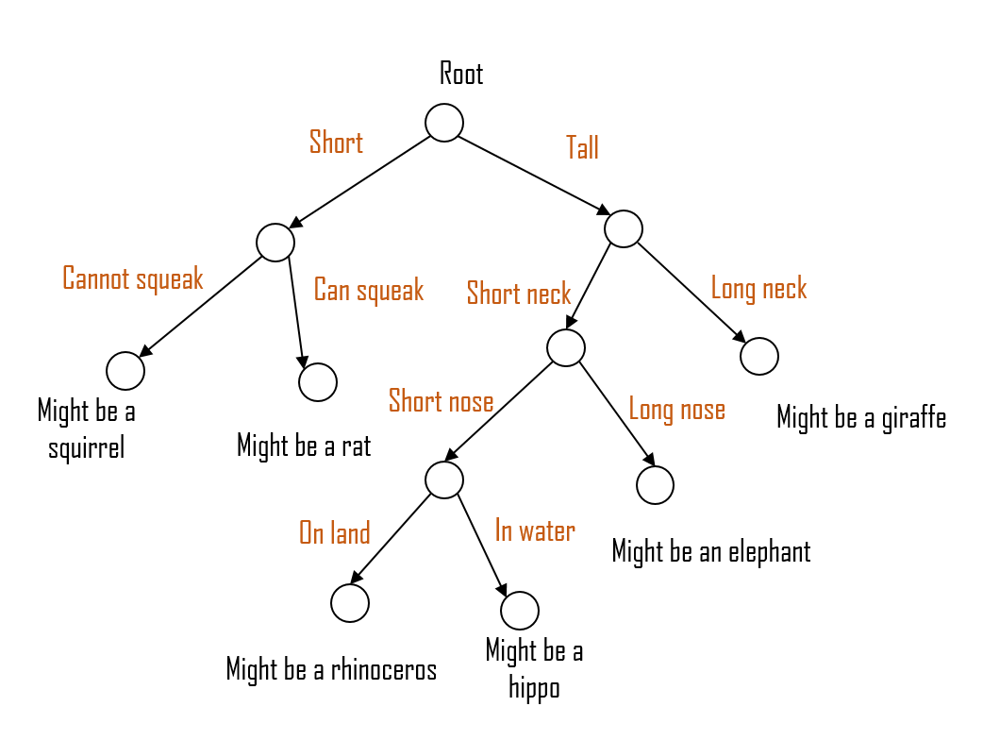
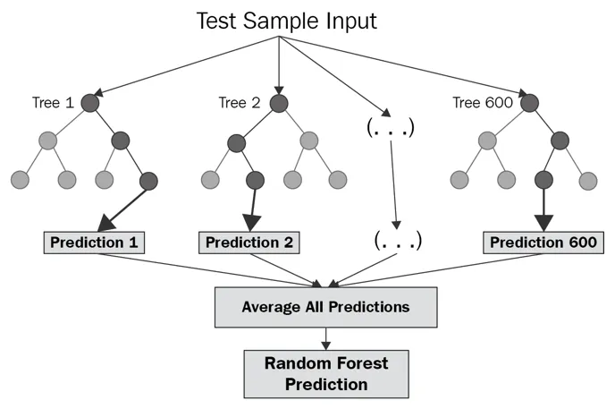
Random Forest
An ensemble-based method composed of some number of Decision Trees

Slide 22
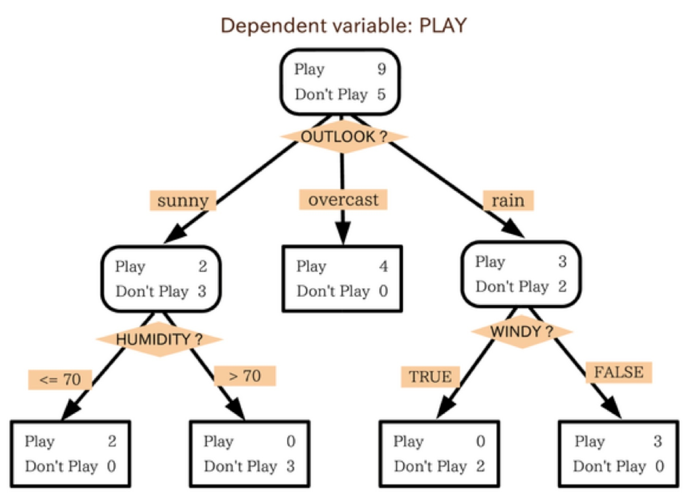
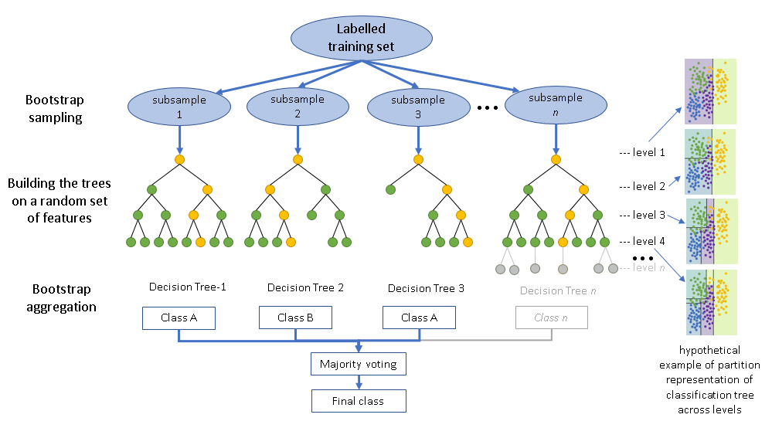
Random Forest
Intuition – Ensemble type of algorithm
It creates a set of decision trees from randomly selected subset of training set.
It then combines votes from different decision trees to decide the final class of the object.
Overcomes overfitting problem of Decision Trees by taking average of all predictions, cancelling out biases.

Slide 23
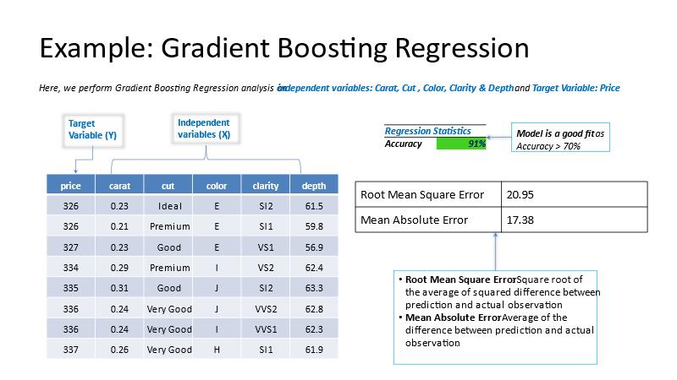
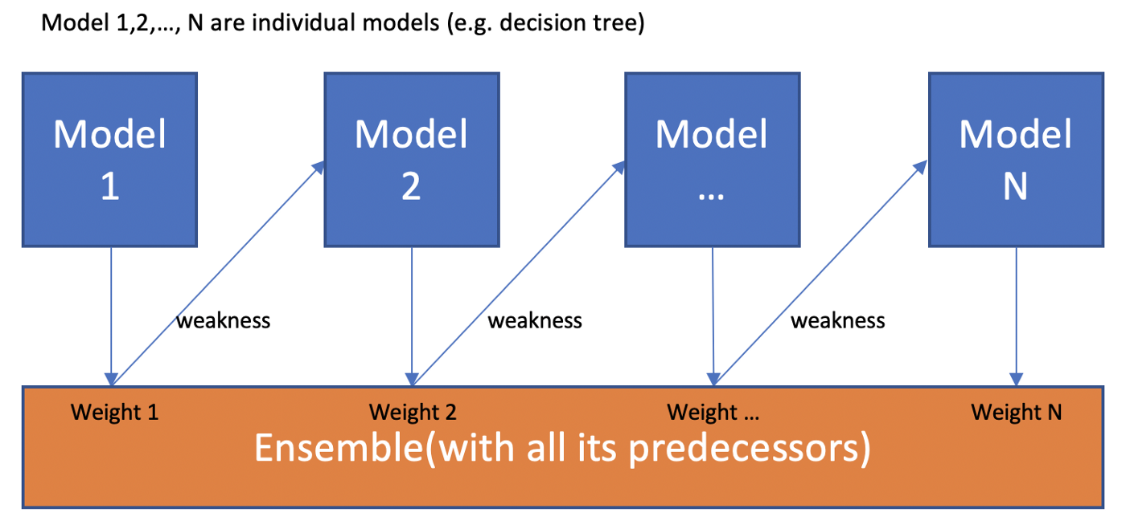
XGBoost
Ensemble based (similar to RF)
Outperforms Gradient Boost with i) in-built Regularization, prevents overfitting,
ii) faster with Parallel Processing,
iii) handle missing values, cross-validation, efficient tree pruning etc.
https://towardsdatascience.com/boosting-algorithms-explained-d38f56ef3f30

Slide 24
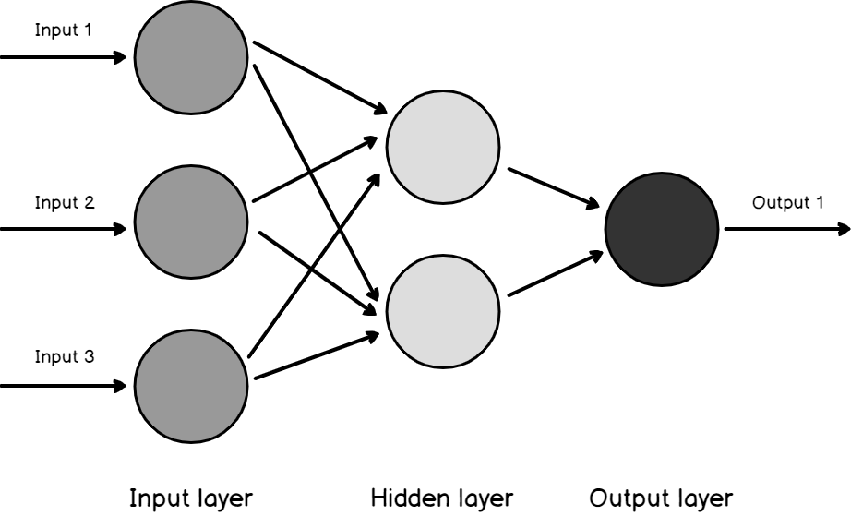
Neural Networks
n1 output = i1*w1 + i2*w2 + i3*w3 (Dot product!)
Requires numeric input
Low explainability
Can add multiple levels for more complex data
i1
w1
n1
w2
i2
w3
i3
24

Slide 25
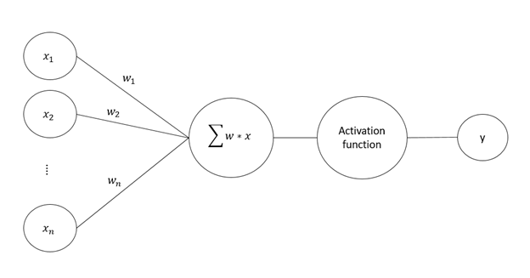
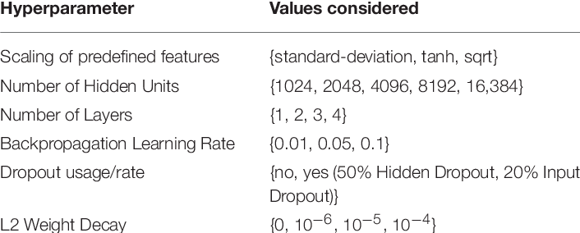
NN Tunable Hyperparameters

